Slide 1
Weather Unit Atmosphere
8-19 to 8-23

Slide 2
Atmospheric Layers
Earth’s atmosphere is the layer of gases that surrounds the planet and makes conditions on Earth suitable for living things.
Earth’s atmosphere is divided into several different atmospheric layers extending from Earth’s surface outward:
Troposphere
Stratosphere
Mesosphere
Thermosphere
Ionosphere
Exosphere
The Steaks Must Thaw In Europe!
Our Restless Atmosphere 11:19
MENU

Slide 3
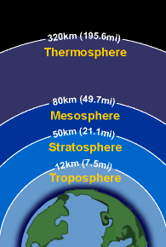
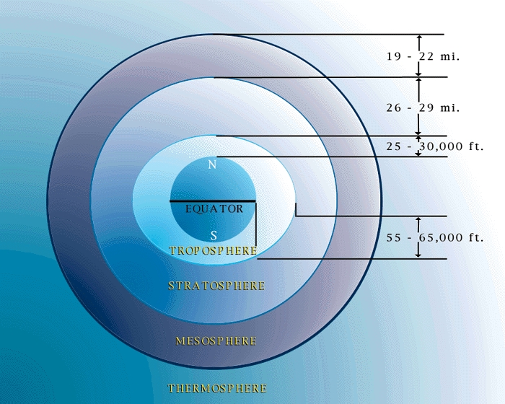
Atmospheric Layers
The layer of gases surrounding Earth; composed mainly of nitrogen and oxygen
MENU

Slide 4
Troposphere
Atmospheric Layers
This is where all plants and animals live and breathe
Where weather takes place
Air is mixes
T decreases with altitude
MENU

Slide 5
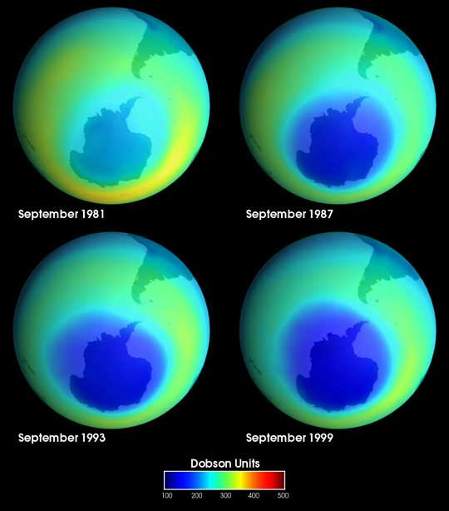
Stratosphere
Atmospheric Layers
Ozone in this layer stops many of the sun's harmful rays from reaching the earth
People can not breathe in this layer.
Ozone layer depletion over time
MENU

Slide 6
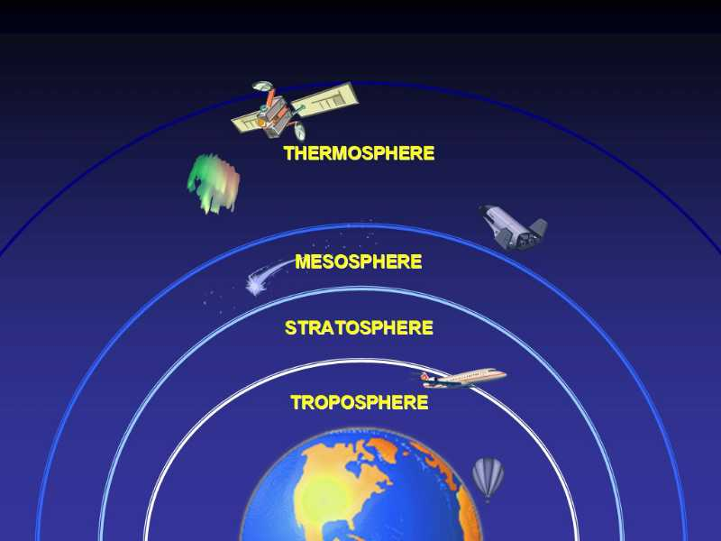
Mesosphere
Atmospheric Layers
T decreases with altitude
This is where we see "falling stars" – meteors burning up as they fall to Earth
MENU

Slide 7
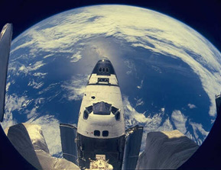
Thermosphere
Atmospheric Layers
Layer of the atmosphere which is first exposed to the Sun's radiation and so is first heated by the Sun.
The air is very thin
The temperature dependent on solar activity.
Thermosphere Cooling - large, QuickTime, 54.7 MB
MENU

Slide 8
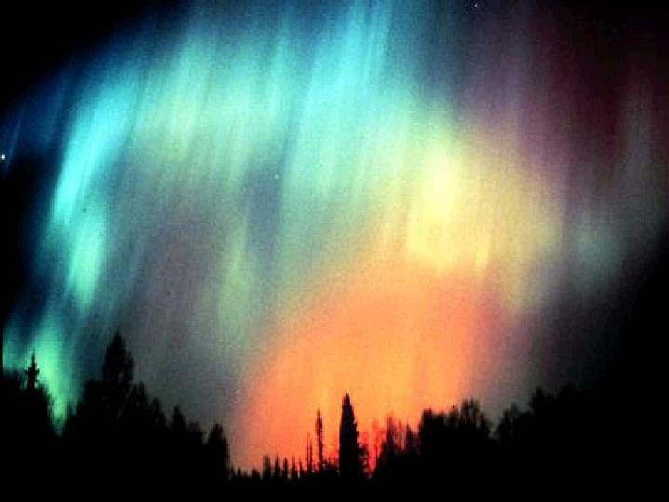
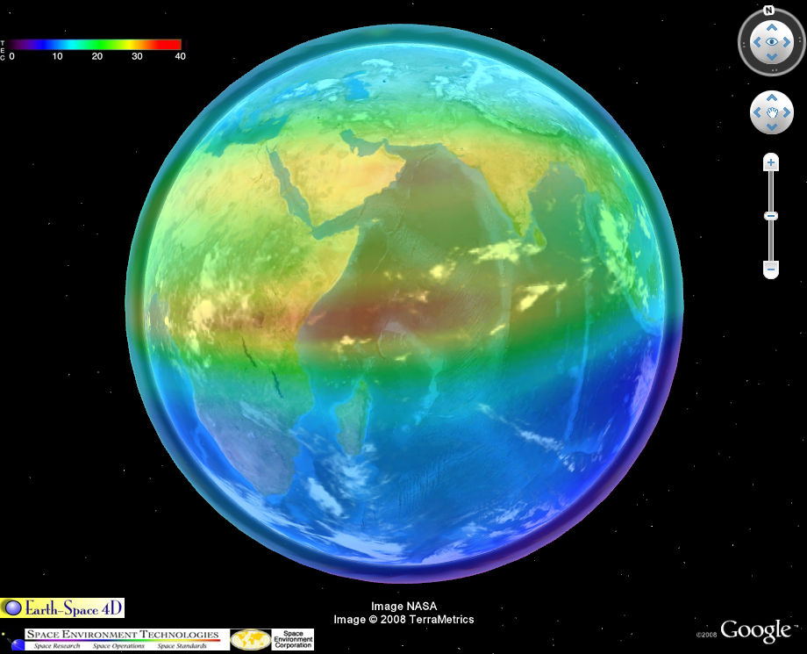
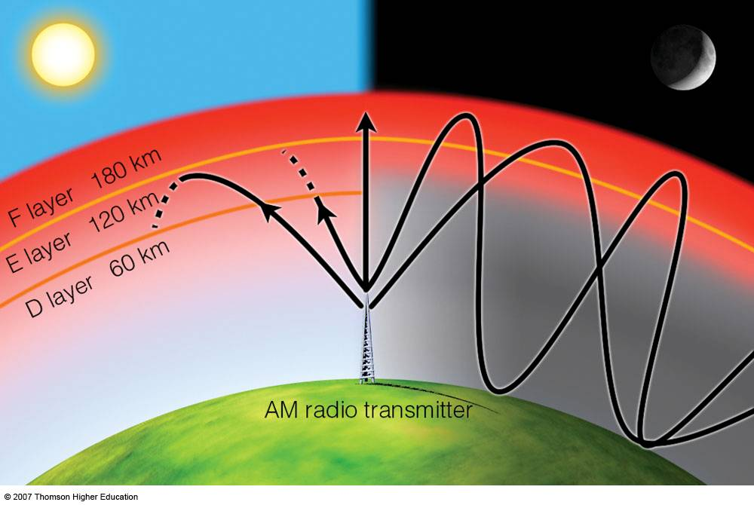
Ionosphere
Atmospheric Layers
An extension or a part of the thermosphere. So technically, the ionosphere is not another atmospheric layer.
Free electrons
and ions tend
to recombine
MENU

Slide 9
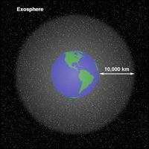
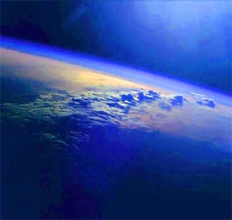
Exosphere
Atmospheric Layers
Exosphere
Highest layer of the atmosphere. The air is very thin here
Atoms and molecules escape into space
Atmospheric Layers Animation
MENU

Slide 10
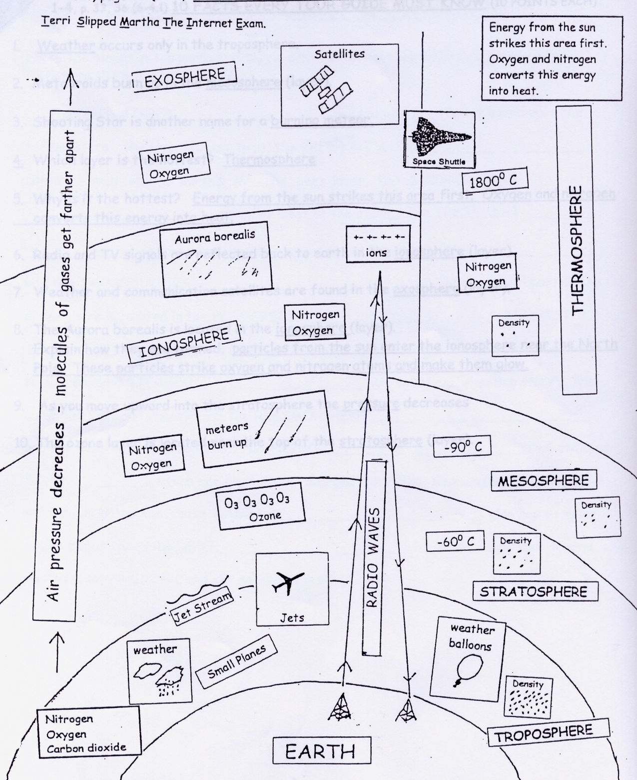
Earth's
Atmosphere

